Slide 1
CLAIMS MANAGEMENT SYSTEM

Slide 2
TABLE OF CONTENTS
OVERVIEW
FEATURES
ARCHITECTURE
Problem STATEMENT
01
02
03
04
05
06
TECHNOLOGY
A CLOSER LOOK

Slide 3
OUR TEAM
ANSH GUPTA
AAYUSH BANGROO
APOORVA S MENON
ANKIT LNU

Slide 4
01
PROBLEM STATEMENT

Slide 5
PROBLEM STATEMENT
A leading HealthCare Management Organization wants to strengthen its middleware by exposing the core logic related to Claims Management as Microservices.
The middleware Microservices are to be hosted on Cloud.
Member Portal to be developed that consumes these Microservices and responds back to members who are in need of Claim related information.

Slide 6
02
OVERVIEW

Slide 7
LIST OF MICROSERVICES
1) MEMBER PORTAL
2) AUTHORIZATION MICROSERVICE
3) MEMBER MICROSERVICE
4) CLAIMS MICROSERVICE
5) POLICY MICROSERVICE

Slide 8
03
FEATURES

Slide 9
FEATURES
The user can insert the claim details like :
ID
Hospital Name
Claim Amount
A claim ID will be generated corresponding to the submitted claim.
SubMIT Claim
CHECK StATus
The user can check the status of a particular claim with the given claim ID. For instance, Claim is pending as more documents are needed for verification.
View bills
The User can see if he/she has any pending bills along with the last premium paid date and late charges

Slide 10
04
ARCHITECTURE

Slide 11
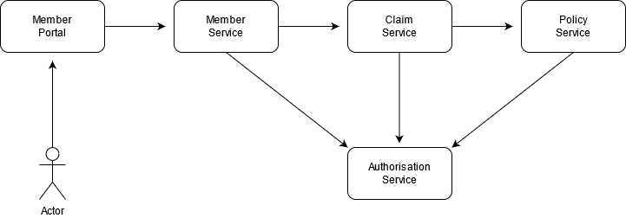
ARCHITECTURE/FLOW DIAGRAM

Slide 12
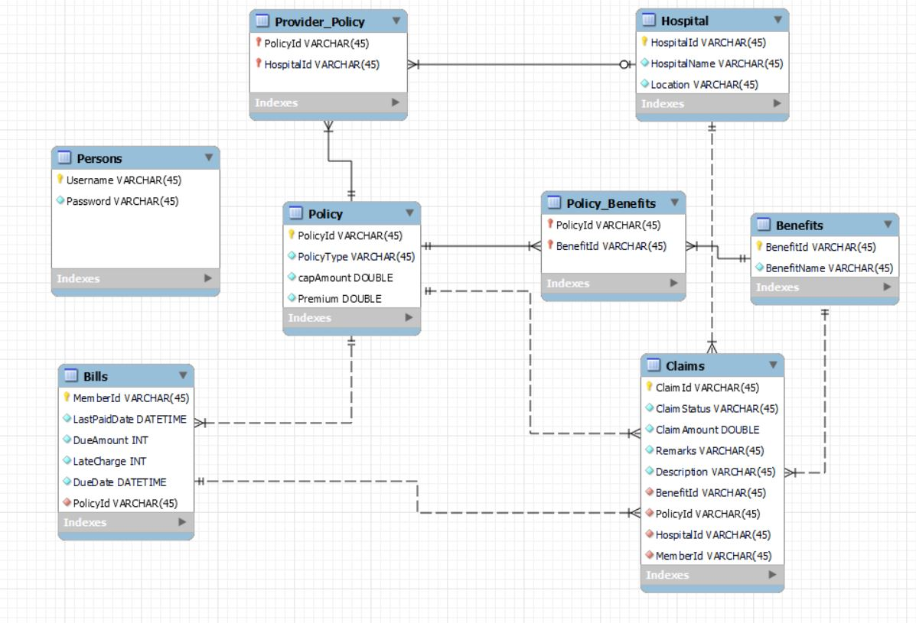
DataBase SCHEMA
Helena james
Jenna doe
“Venus has a beautiful name and is the second planet
from the Sun. It’s terribly hot”

Slide 13
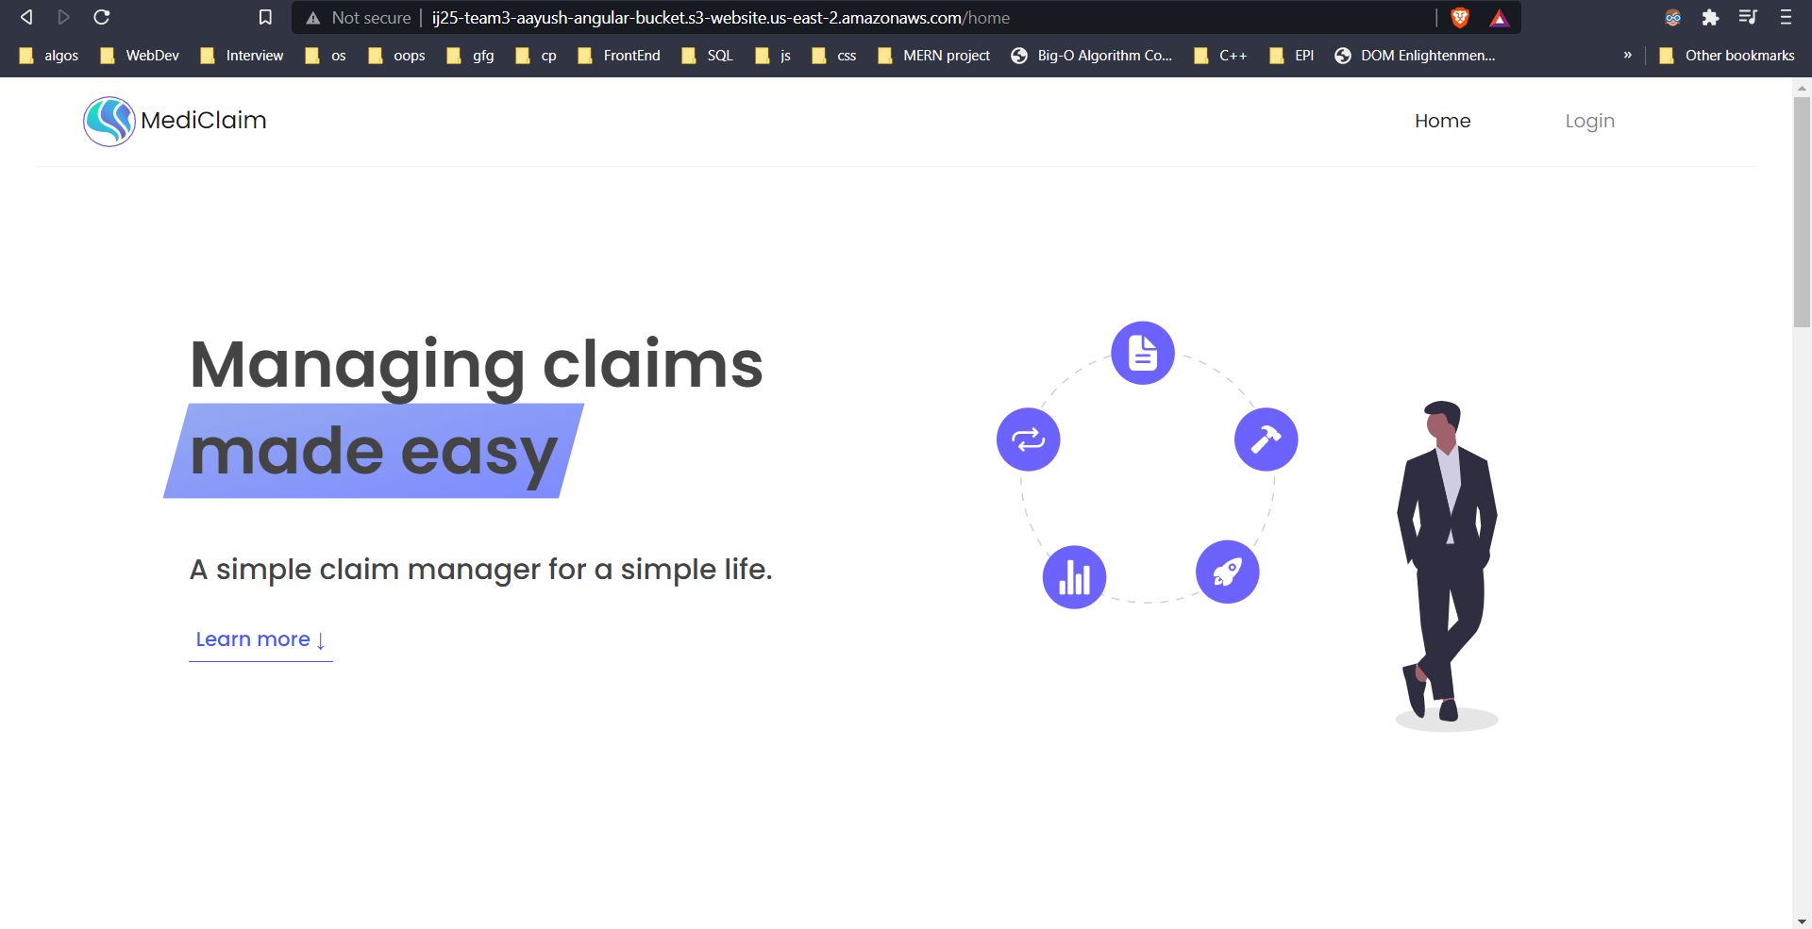
MEMBER PORTAL

Slide 14
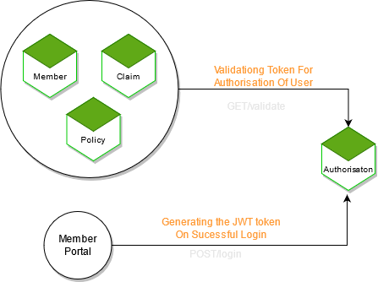
AUTH MODULE

Slide 15
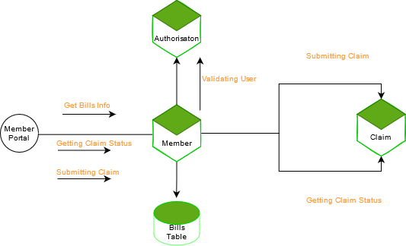
MEMBER MODULE

Slide 16
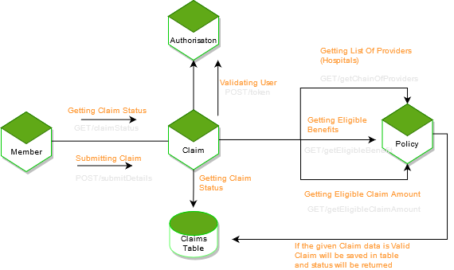
CLAIMS MODULE

Slide 17
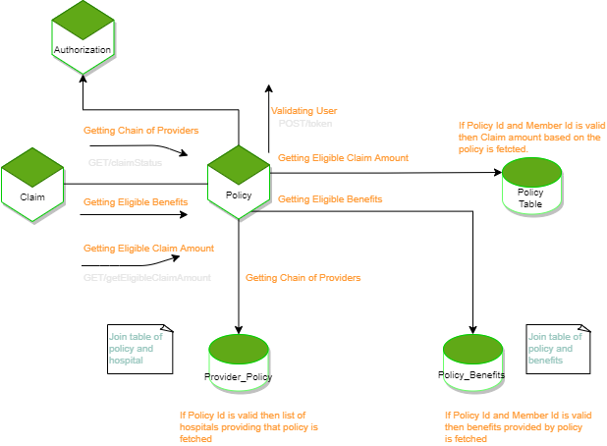
POLICY MODULE

Slide 18
05
TECHNOLOGY

Slide 19
TECHNOLOGY/FRAMEWORKS USED
FRONTEND
BACKEND
Angular
Spring MVC with Spring Boot
Spring Data JPA, H2 In Memory DB
TESTING
jUnit 4/jUnit 5
Mockito

Slide 20
DEVOPS & CLOUD
ANCILLARY
Docker
AWS CI/CD
AWS ECS
AWS S3
Maven
Lombok
CODE QUALITY
SonarQube
SonarLint

Slide 21
07
A CLOSER LOOK

Slide 22
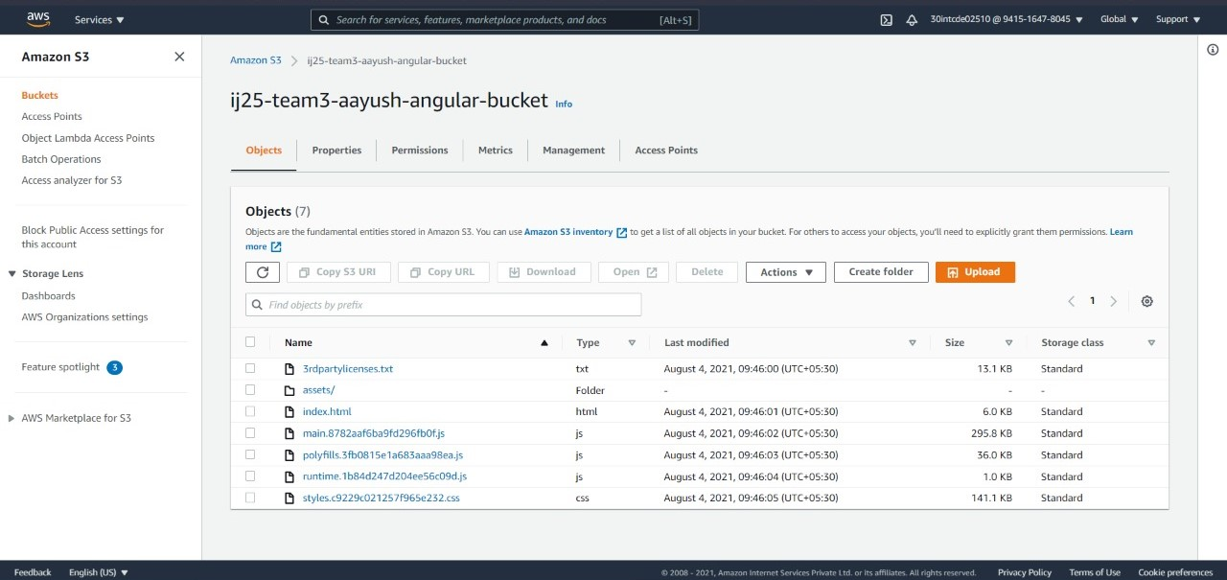
Angular app hosted on S3 BUCKET

Slide 23
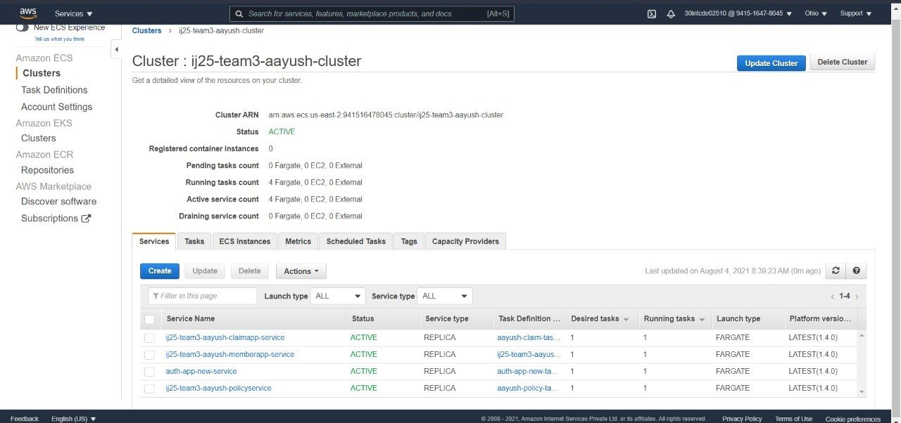
CLOUD DEPLOYMENT - CLUSTER(SERVICES)

Slide 24
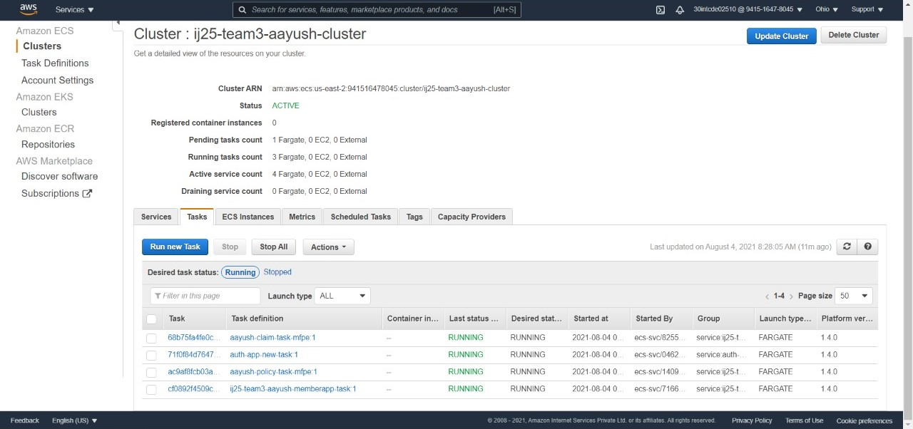
CLOUD DEPLOYMENT - CLUSTER(TASKS)

Slide 25
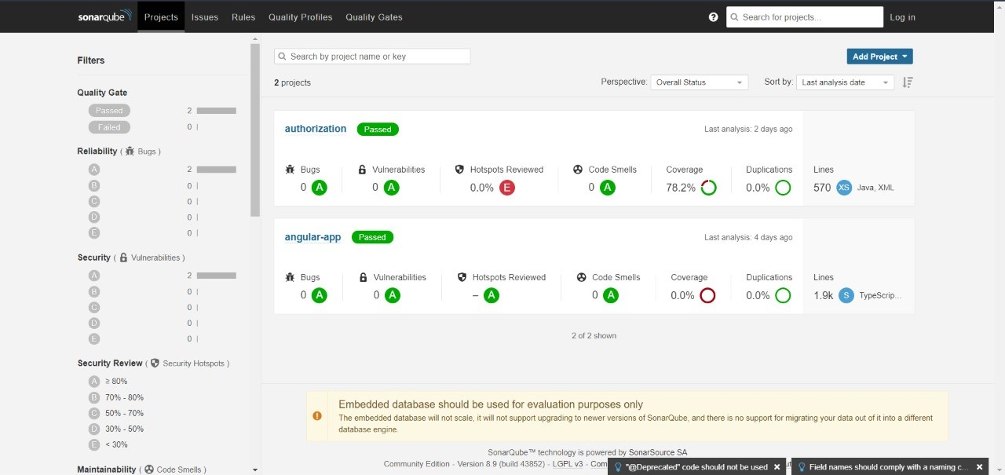
CODE QUALITY USING SONARQUBE

Slide 26
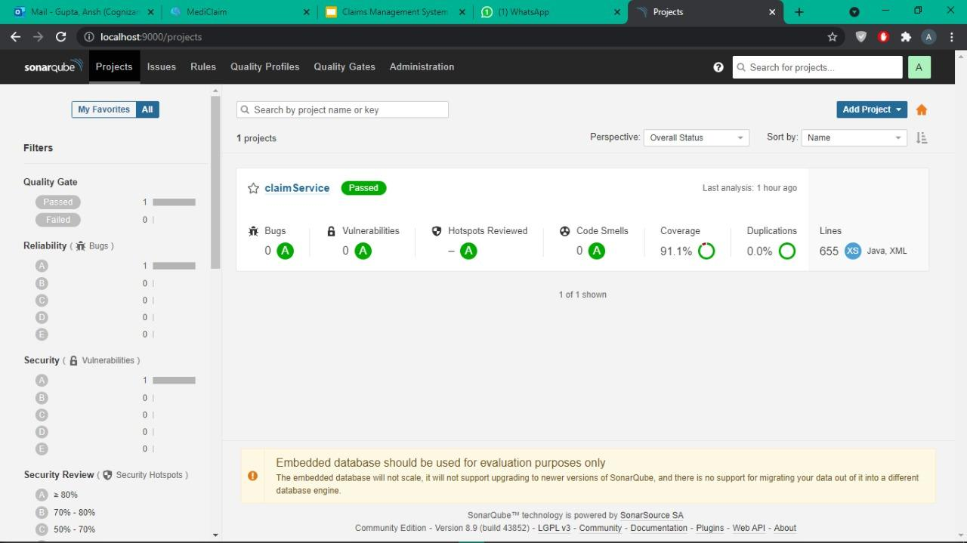

Slide 27
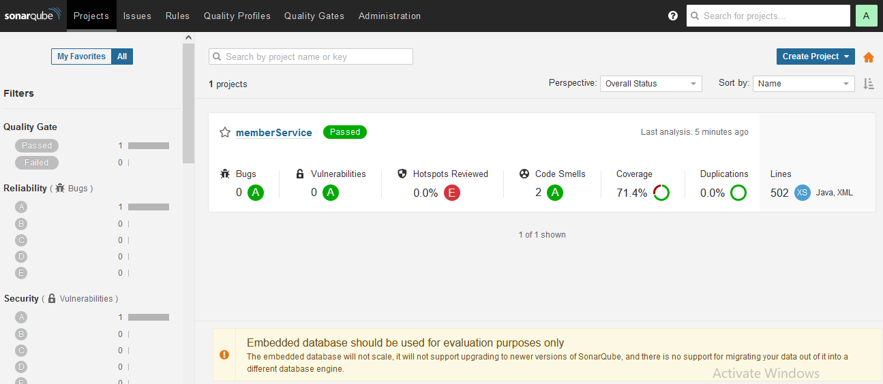
CODE QUALITY USING SONARQUBE

Slide 28
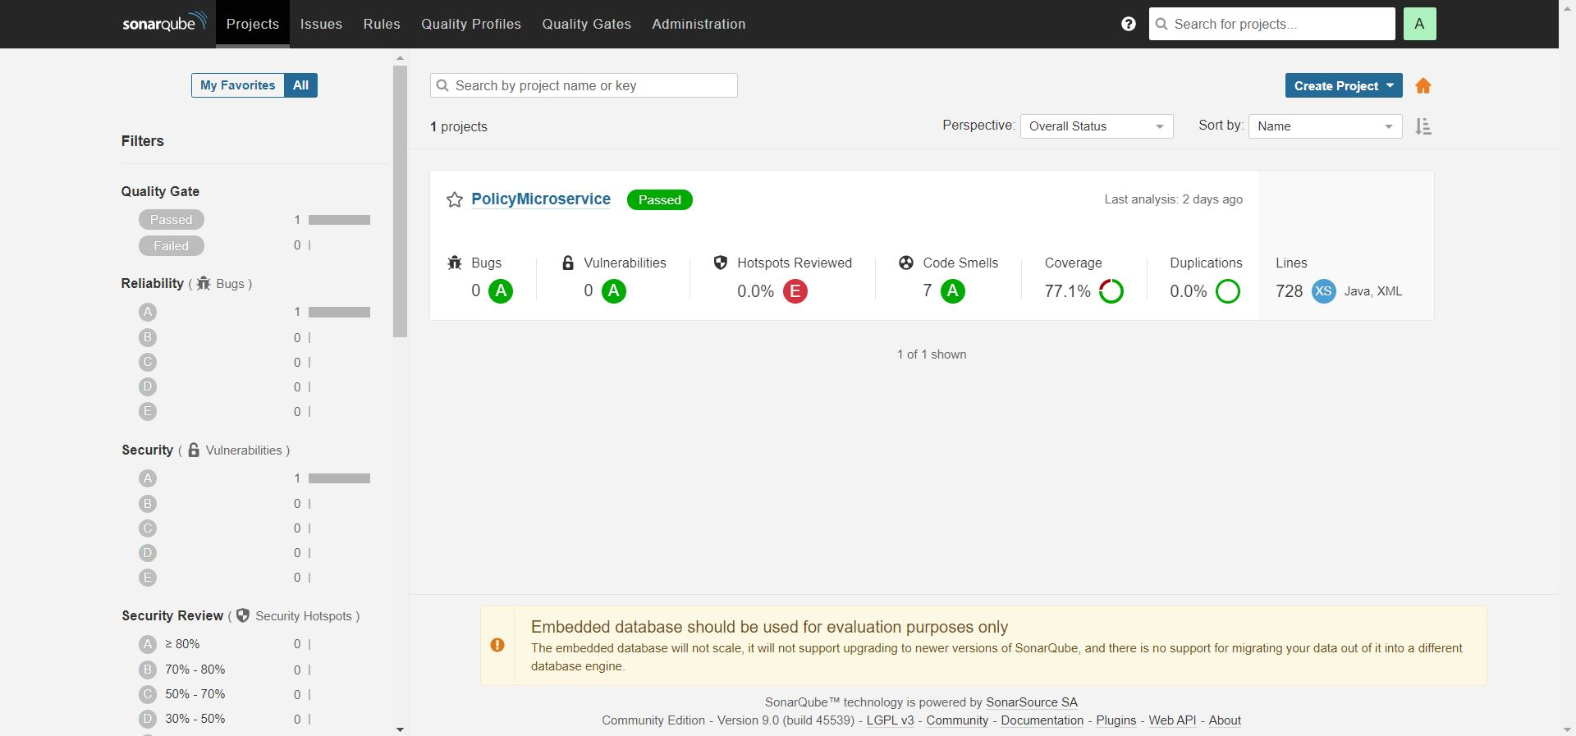
CODE QUALITY USING SONARQUBE

Slide 29
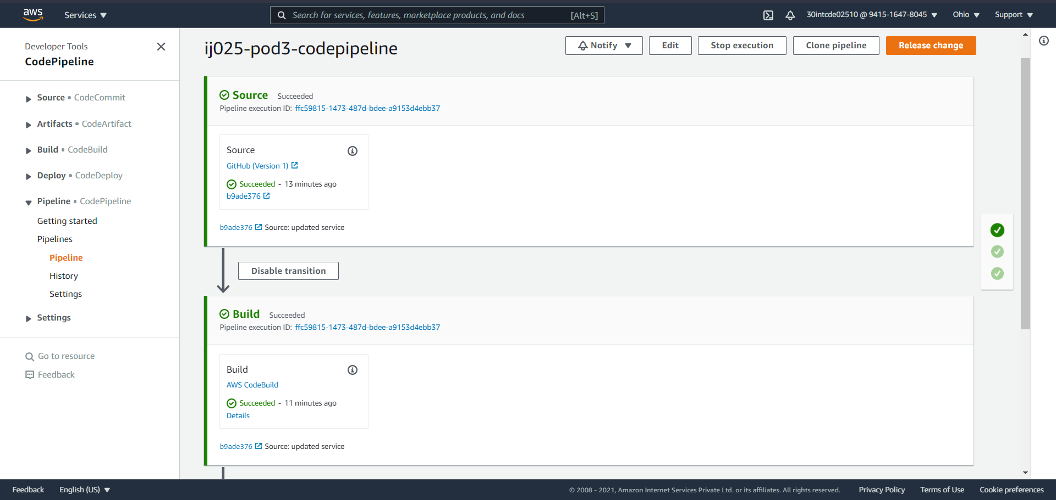
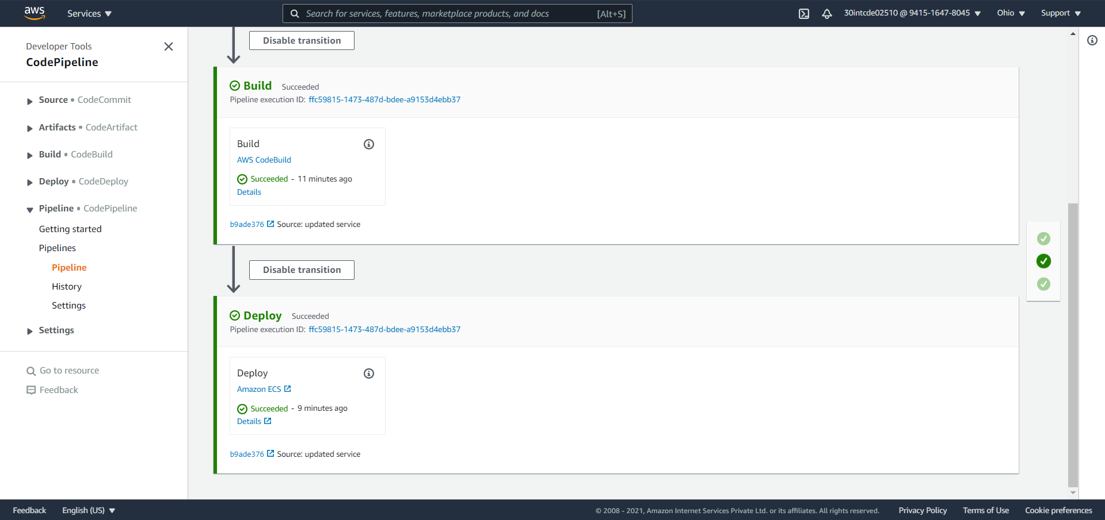
CLOUD DEPLOYMENT - AUTH PIPELINE

Slide 30
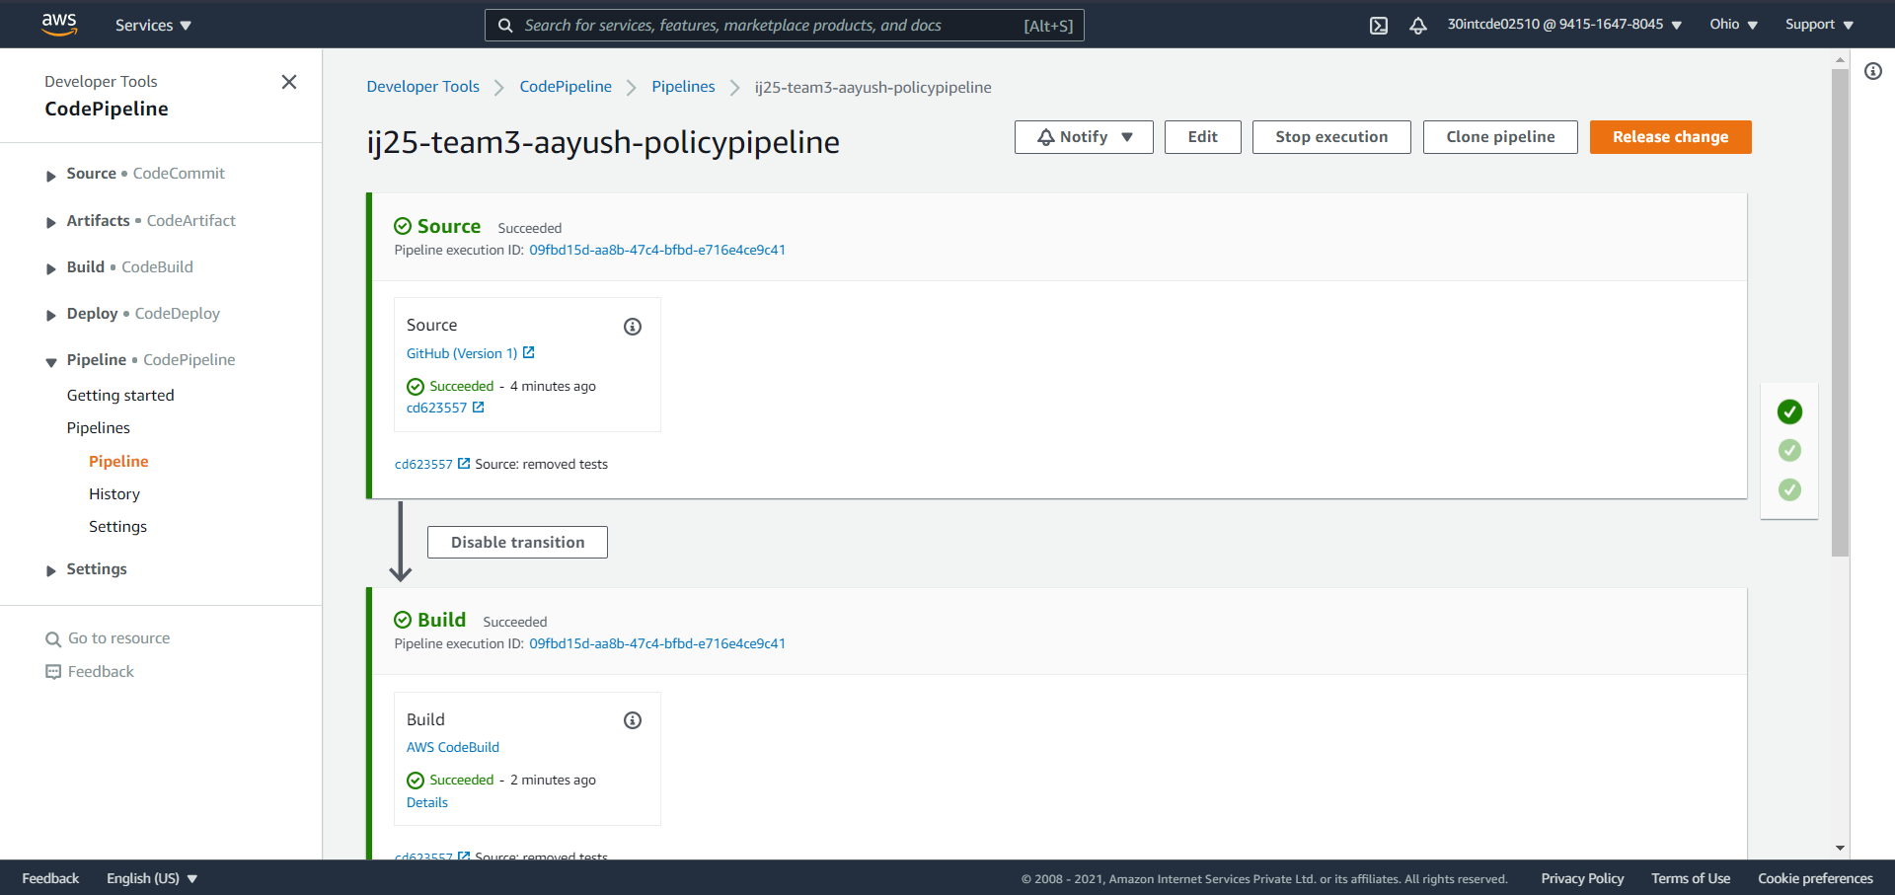
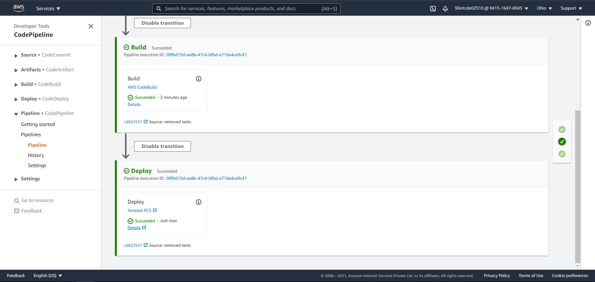
CLOUD DEPLOYMENT - POLICY PIPELINE

Slide 31
THANK YOU!

